Slide 1
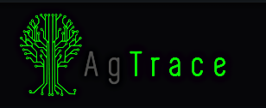
FOOD PRODUCTION TRACKING BLOCKCHAIN
PERCIVAL LUCENA

Slide 2
About AgTrace
AgTrace (is a traceability solution that ensures transparency and information reliability, reducing response time to issues within the food value chain. Based on farming processes analysis and advanced IoT and blockchain technologies, AgTrace guarantees information security about agriculture processes, using sensors and equipment to register information from inside and outside the farm.
The project has started as a Partnership with Solinfitec a company with 15 years experience on Agriculture Systems and Brazilian leader on Sugar Cane Systems
A new company called AgTrace was created for Traceability projects for Organic Food and Special Coffee
The project was first deployed on Rizoma Fazenda da Toca in Sao Paulo state.
A second pilot is being tested on a special coffee producer.
The project has been nominated one of the 8 most innovative Agriculture projects @World Agri-Tech Innovation Summit 2019 https://worldagritechusa.com/radicle-challenge/#TheFinalists

Slide 3
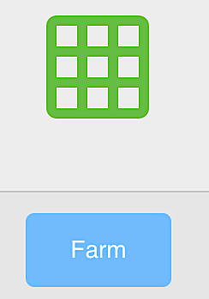
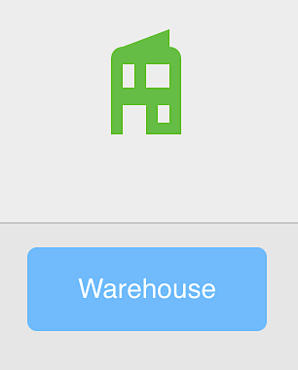
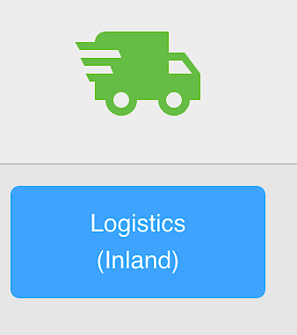
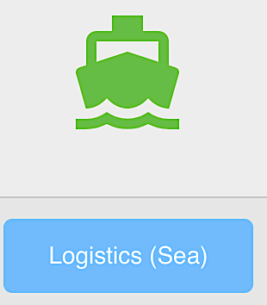
AGTRACE – BLOCKCHAIN NETWORK
Validating peer node
Validating peer node
Shared ledger
Smart Contract
Validating peer node
Validating peer node

Slide 4
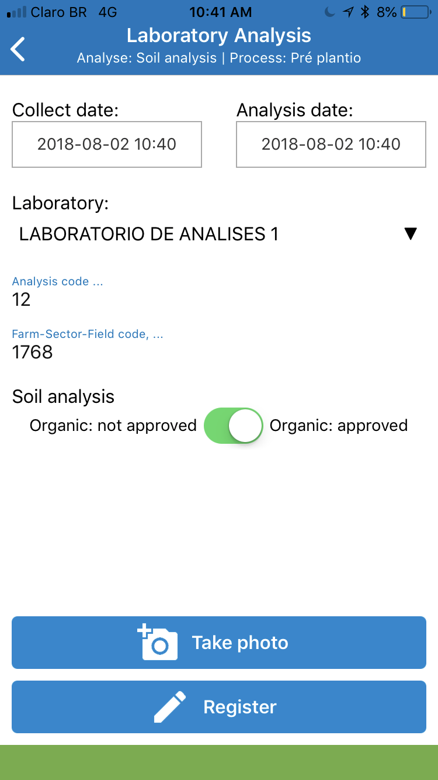
Organic Products Tracking
Solinfitec SGPA is a farm office planning system who provides operation information for tractors on board computers.
Connectivity between devices provided by a mesh network
Solinfitec already deployed on 6 million hectares and +30.000 equipment
Agtrace Blockchain is a project to create a Hyperledger 1.1. blockchain network to provide farm production information

Slide 5
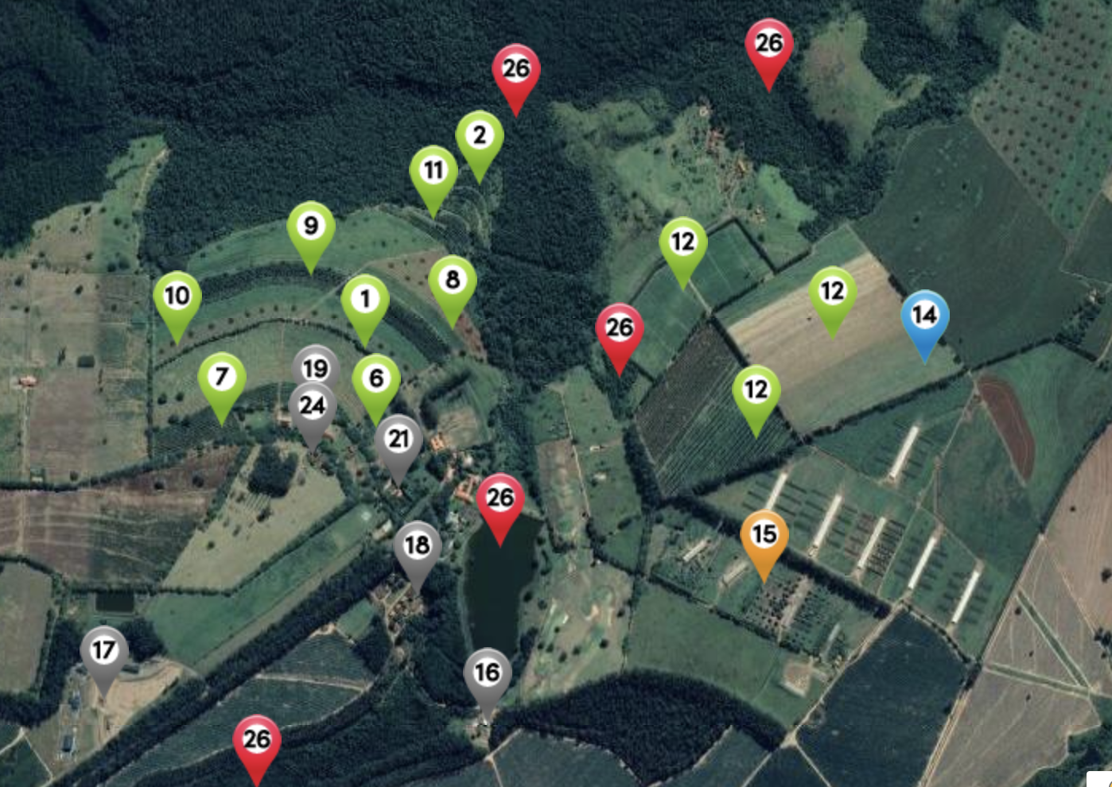
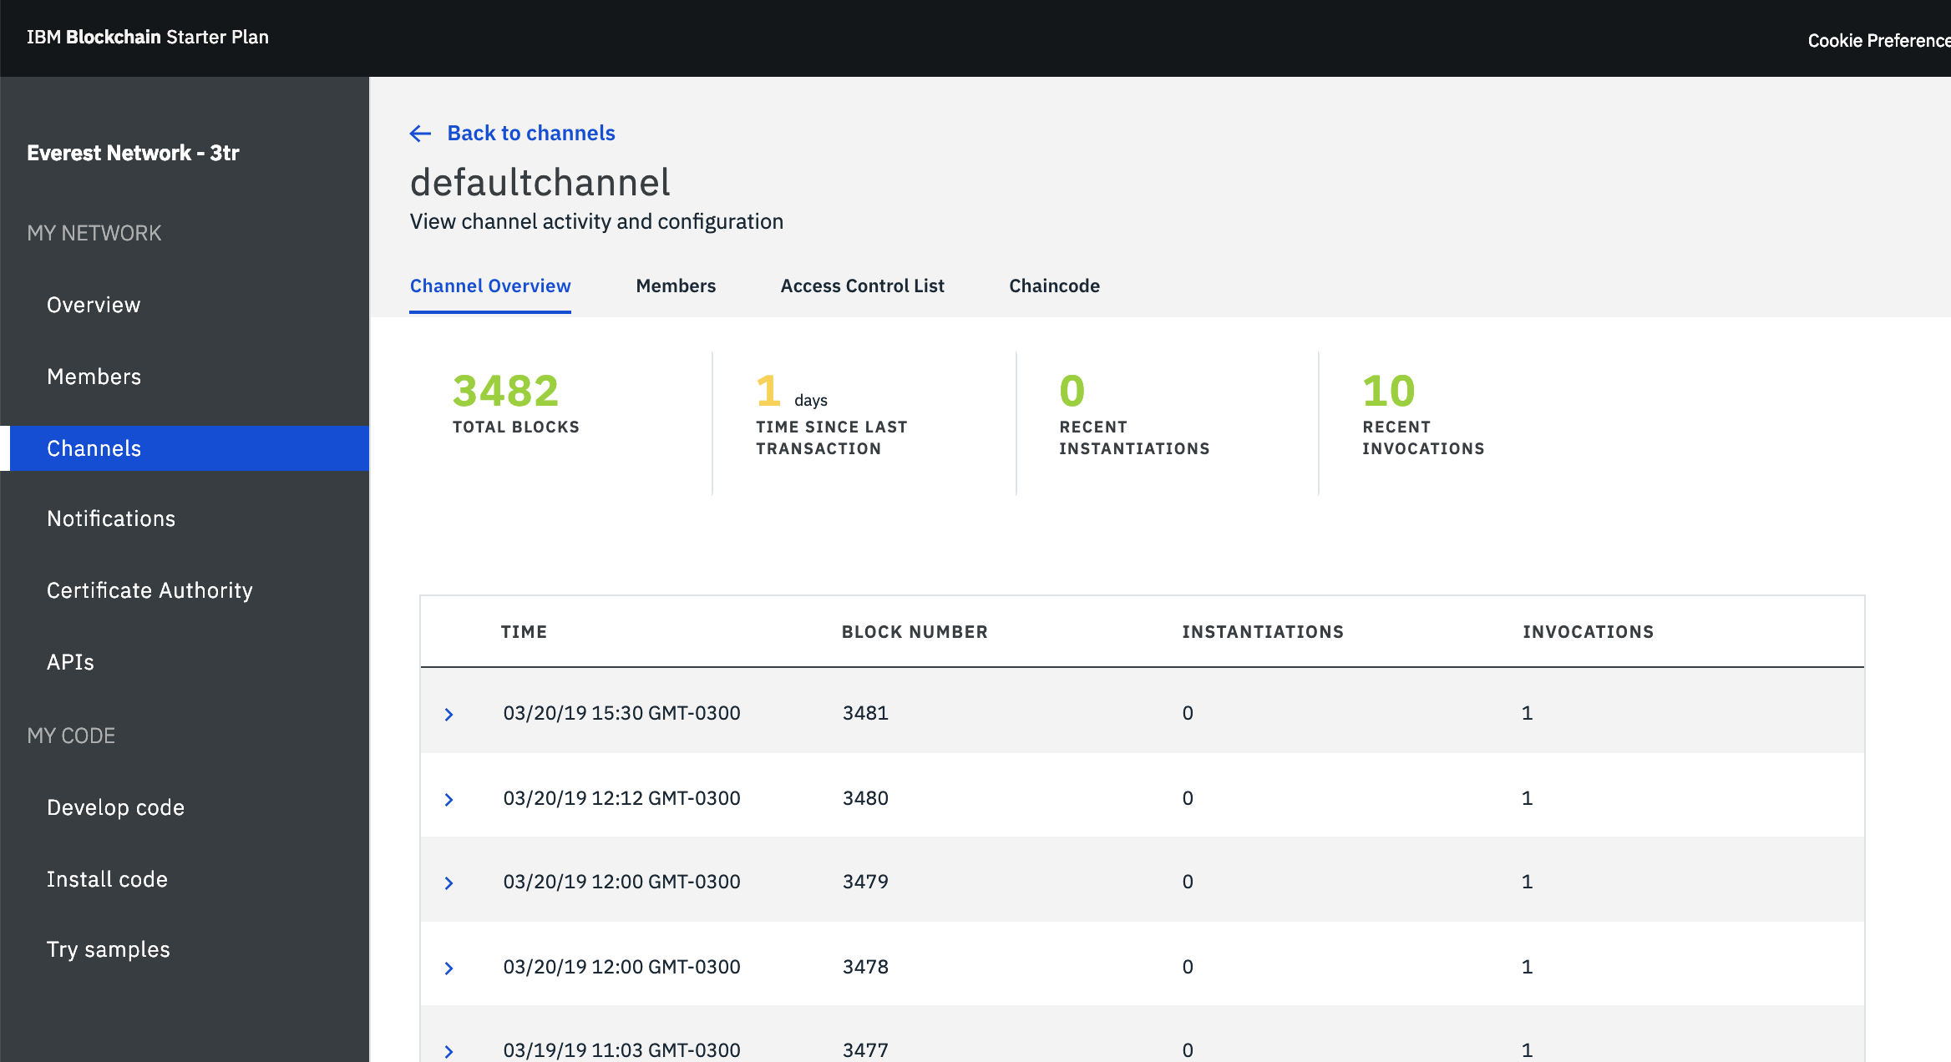
Organic Products Tracking
Pilot
Deployed on Rizoma Fazenda Da Toca in Itirapina São Paulo
Organic Corn Tracking https://bit.ly/2U4DES0
IBM Blockchain Network 3K + events captured

Slide 6
Farm as a System * * Cambridge IGCSE Agriculture
Any farm can be viewed as a system, with inputs, processes, outputs and feedback
Inputs can be divided into two groups.
Physical inputs are naturally occurring things such as water, raw materials and the land.
Human or Cultural Inputs are things like money, labor, and skills.
Processes are the actions within the farm that allow the inputs to turn into outputs. Processes could include things such as milking, harvesting and shearing.
Outputs can be negative or positive, although they are usually the latter. Negative outputs include waste products and soil erosion. The positive outputs are the finished products, such as meat, milk and eggs, and the money gained from the sale of those products.
Feedback is what is put back into the system. The main two examples of this are money, from the sale of the outputs, and knowledge, gained from the whole manufacturing process. This knowledge could then be used to make the product better or improve the efficiency of the processes.

Slide 7
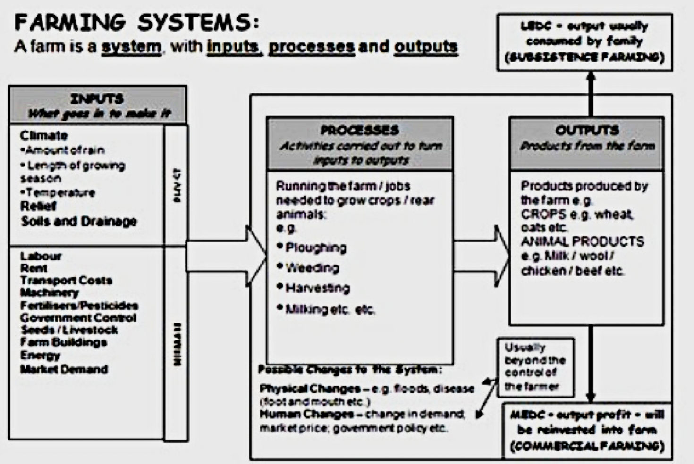

Slide 8
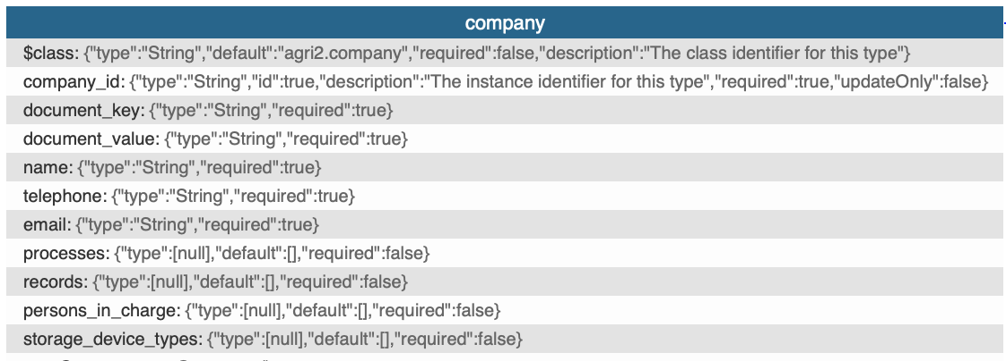
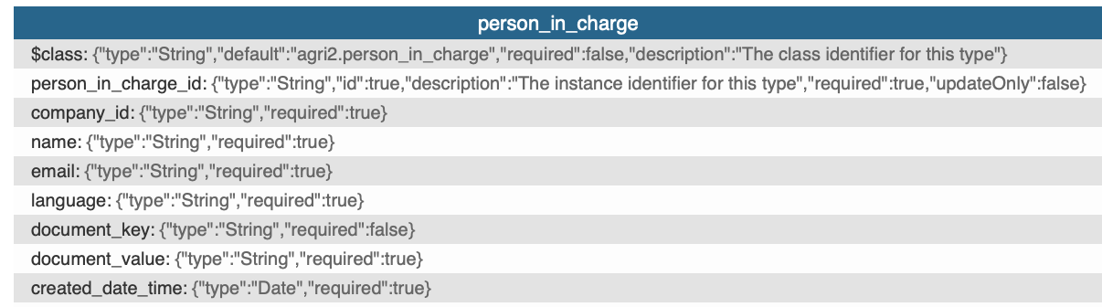
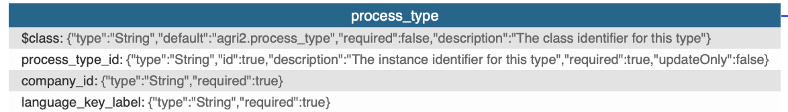
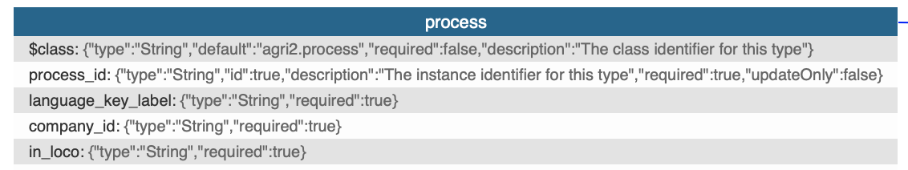
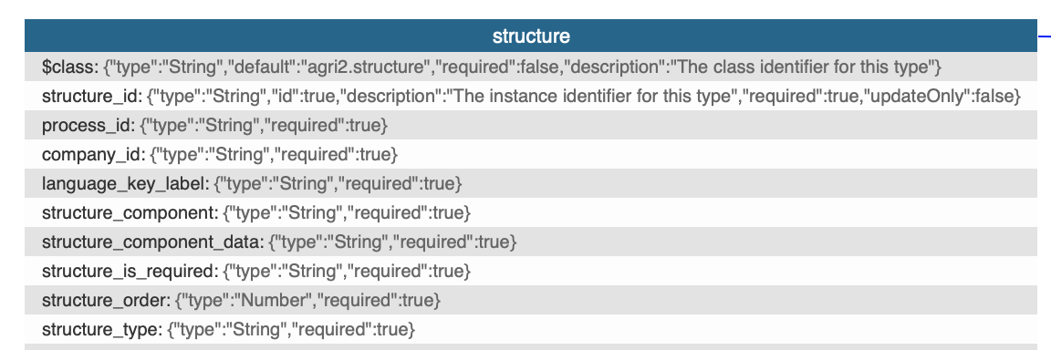
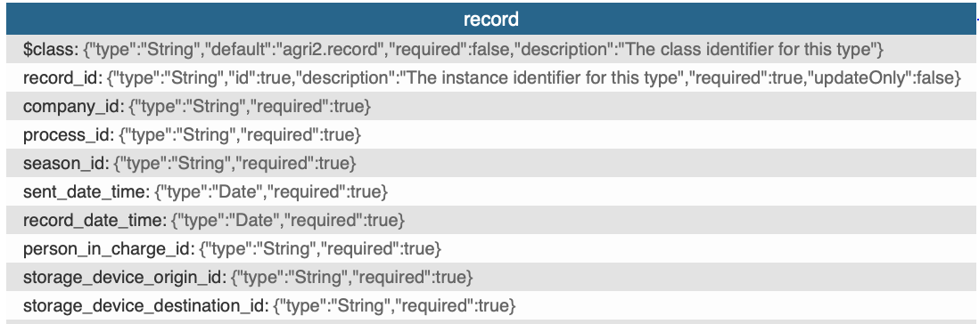
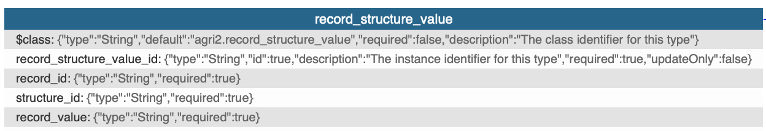
PRODUCTION PROCESS

Slide 9
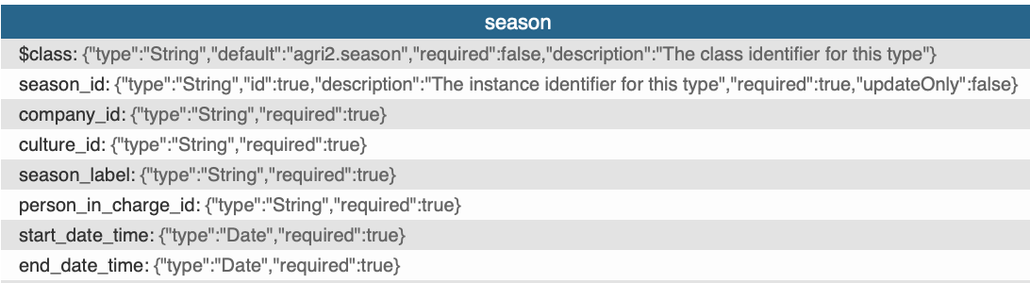
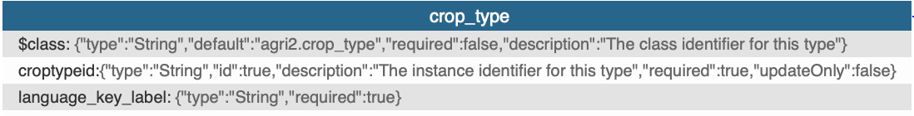
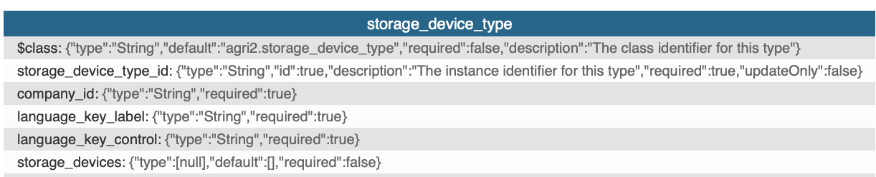
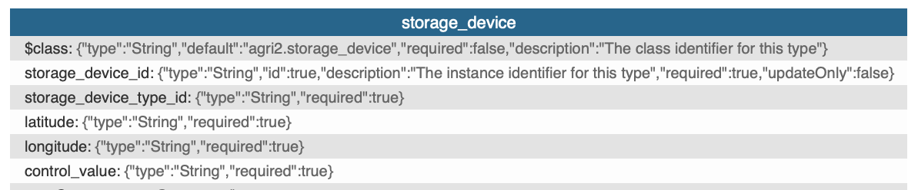
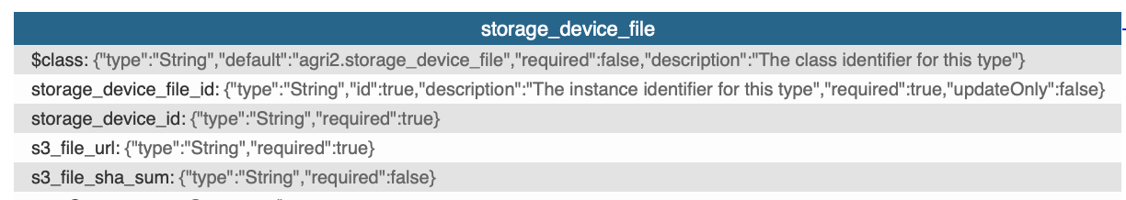
STORAGE PROCESS (includes field)

Slide 10
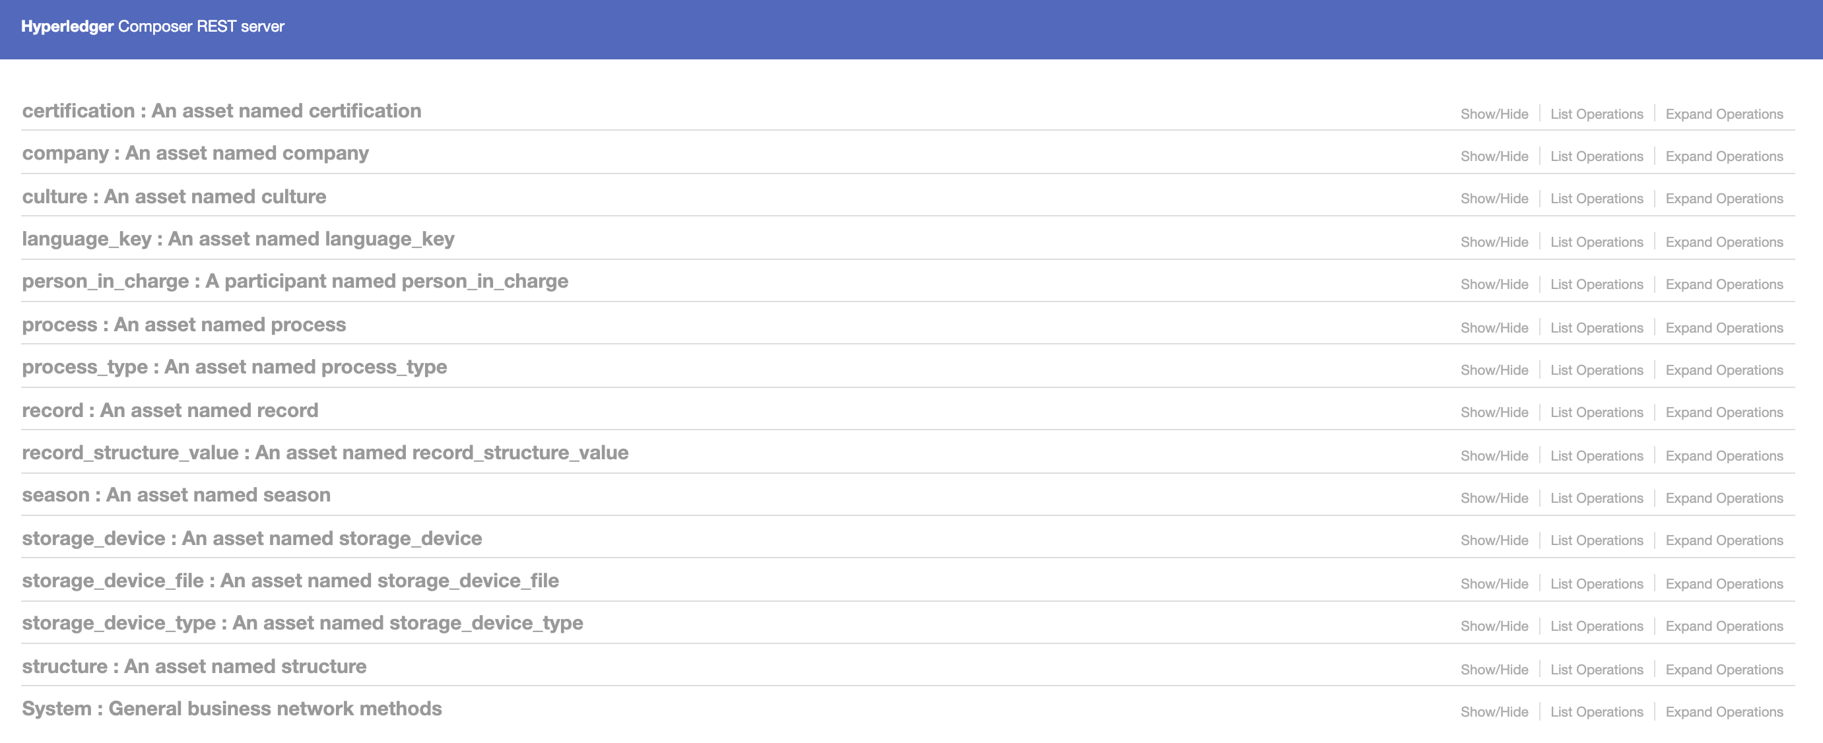
Agtrace- API connects UI and Blockchain

Slide 11
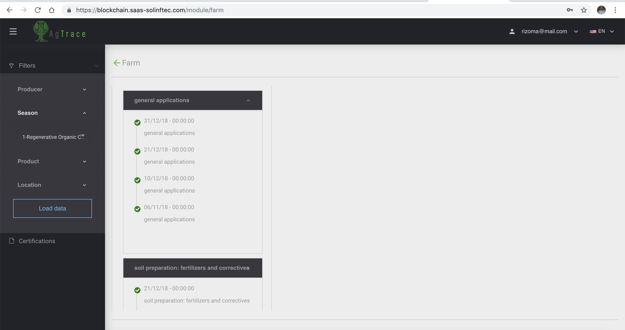
Agtrace- UI

